Slide 1
IdrottOnline
For instructors

Slide 2
IdrottOnline
There is a web browser client, and an app available for download.
As an instructor, the main use of IdrottOnline is to:
Register participation for your group.
Schedule activities (training sessions) for your group.
Adjust group membership – i.e. adding (and removing) members so that each group in IdrottOnline contain the members active in it.
There are groups for each discipline: Longsword, sword and buckler, and so on.
You can also use it to quickly send email or text messages to the members of a group, if you have to cancel a class last-minute, for instance – and a lot more.
Please note that you can only do any of this for the group/groups for which you are a registered administrator on IdrottOnline.

Slide 3
Register participation
Adjust group membership
Scheduling
Easily done through the app at the time of the training.
Starting with a name call also makes it easier to learn the names of people in your group.
Requires internet access.
Can also be done through web client.
Can be done afterwards.
Can be done both in the app or through the web client.
Web client allows for repeated scheduling (eg every Monday at 21.00), so I recommend using it to set up the semester ahead of time.
Greater overview and access in web client.
In-app addition of members requires personal number OR that the person you are adding is a member of a group you are administrator of.
For this purpose, a group might be created containing all/new members for all instructors.
Individual members needs to be registered in IdrottOnline as members of the club for you to be able to add them to a group. This is handled when they sign up for the club. If you cannot find someone, they might not be registered.

Slide 4
Web client
Idrottonline.se
Log in through the padlock symbol in the upper right – details provided by the club.

Slide 5
Home page for the club.
As an instructor, you will be mostly using:
Administration
Aktivitet
Let’s start by pressing “Administration” in the top menu.

Slide 6
Administration
To access group administration, go to “Grupper” in the left-hand menu and select the group you want to access.

Slide 7
Group administration allows you to adjust the members of the group, and to send messages to all or select members of the group through text or email (if their number and email are registered). (Since I do not want to show the actual list of people and their details here, the pictures only show the upper part of the screens.)

Slide 8
Aktivitet
Hitting “Aktivitet” in the top-menu gets us here.
The main things you will be doing here is to schedule activities (training sessions).
This is also where you can register participation – “Närvaroregistrering”.

Slide 9
Scheduling
Go to “Aktiviteter” in the left-hand menu.
To schedule a new activity, hit “Skapa aktivitet” on the right.

Slide 10
Scheduling
Here you fill in the details of your session.
Note that the first option “Kalender” determines which group of members the activity will be applied to (here Sword and buckler).
In the bottom right of this screen you will also get the option to repeat the activity (next slide).
When finished, save by pressing “Spara”.

Slide 11
Repeated activities
Here you can set up repeated activites through a set time period or number of sessions.
Activities can be individually removed or adjusted afterwards if necessary.

Slide 12
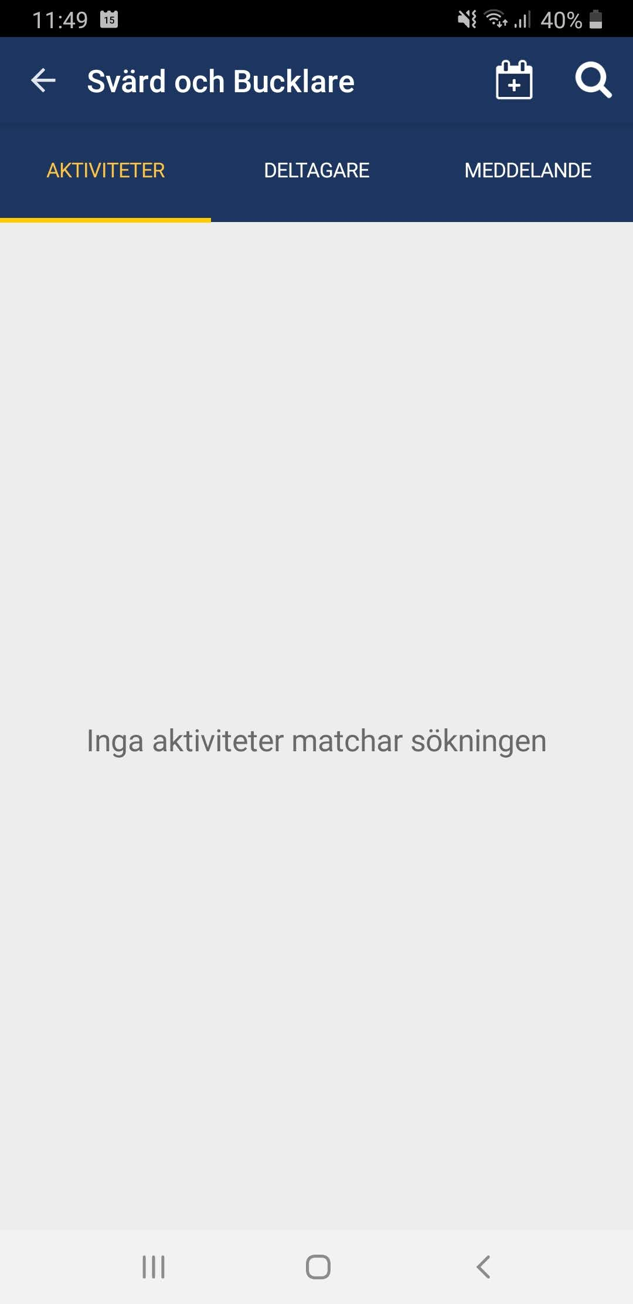
Mobile app
Using the mobile app requires internet access. It can be a bit finicky at times, require you to sign in multiple times etc.
Overall, however, I have found it works well.
After signing in using your login details, you get the following screen, which will take you to the options for your group.
Note that in the third picture, no activities are currently scheduled for the group.

Slide 13
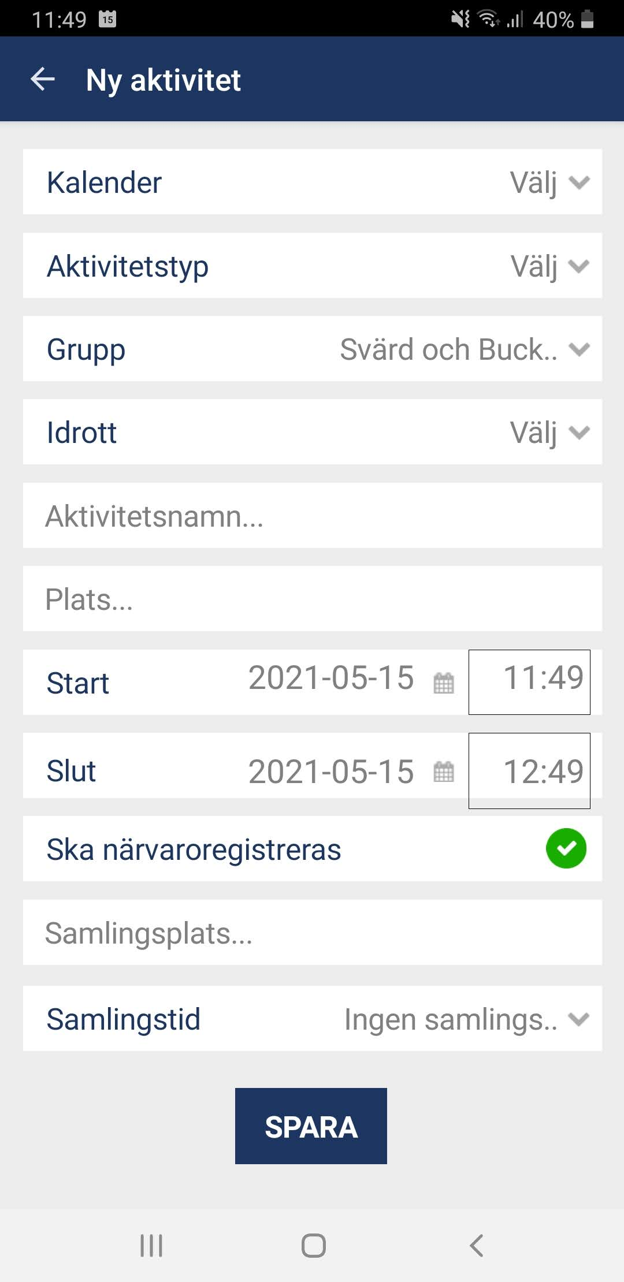
Scheduling activities in the mobile app
Press the calendar icon in the top right and enter the details for the activity. Here, you can only schedule one activity at a time.
Note that both “Kalender” and “Grupp” should be the appropriate group – here sword and buckler is already selected as the group, since we are creating an activity within that group.

Slide 14
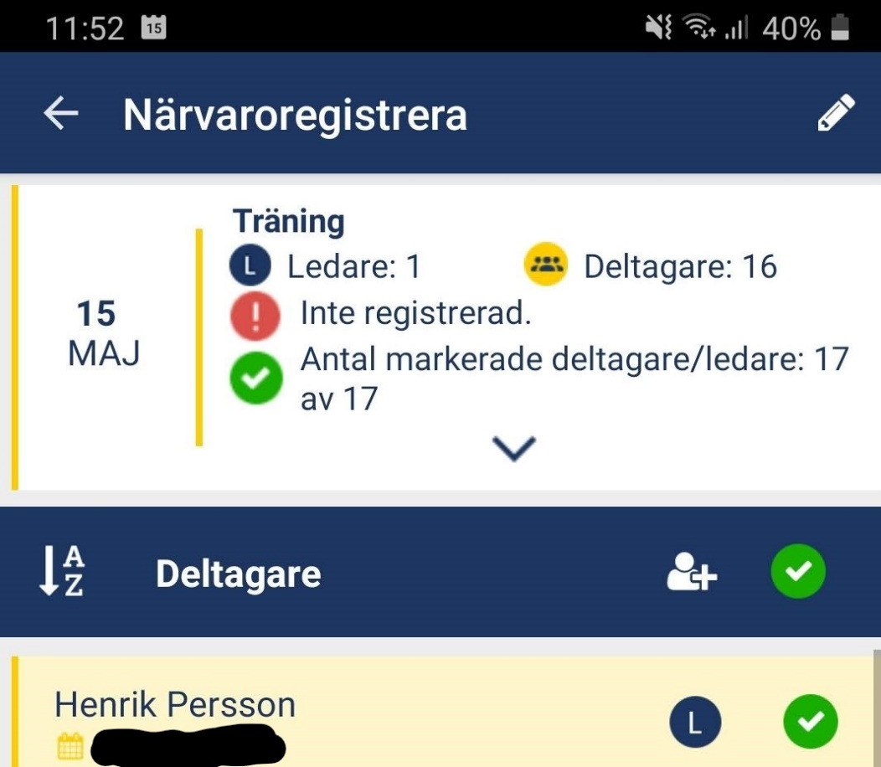
Registering participation
If there are activities scheduled, they show up as here.
Click on the activity for which you want to register participation.
A list of all members in the group (here sword and buckler) will be displayed. Simply check or uncheck them with the green checkmarks, and click “Registrera aktivitet” at the bottom at the screen when you are done.
The list is not shown fully here.

Slide 15
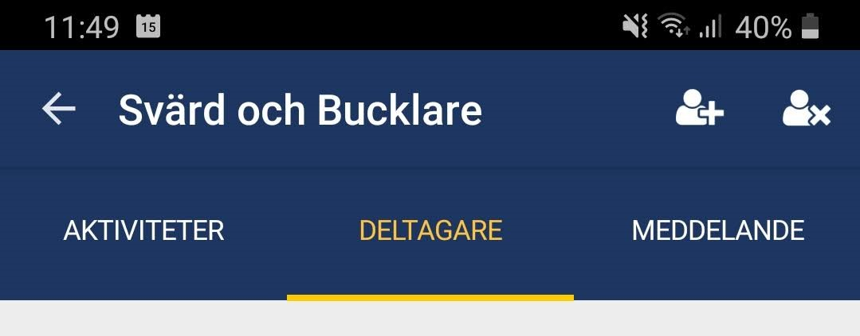
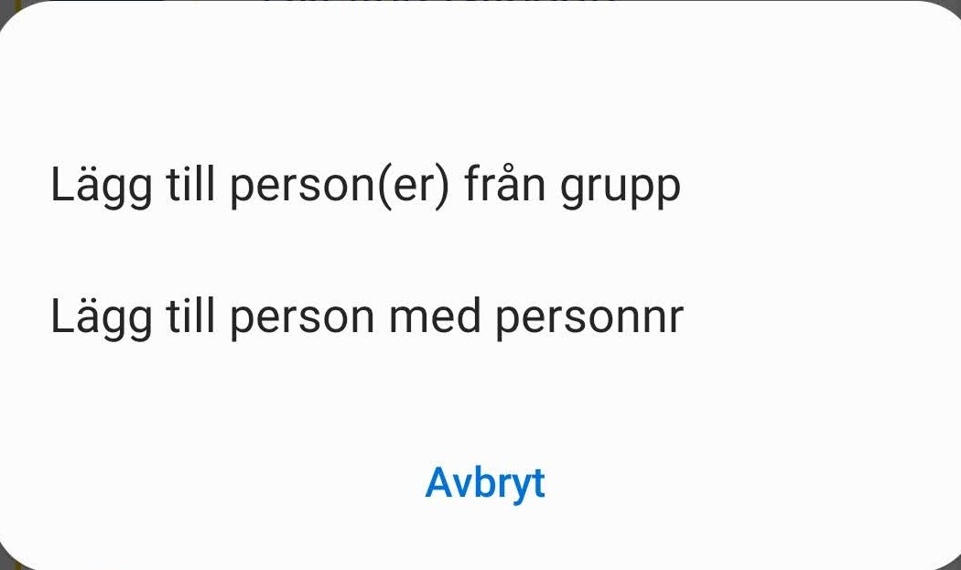
Managing group members
Selecting “Deltagare” at the top allows us to view, add and remove members of the group. Again, the list of names is not shown.
Clicking on a name brings up information registered for that person, including contact details.
Add or remove members to the group by using the icons in the top right. Unlike in the web client, you can only add members is you have their personal number, or if they already are members of another group you have access to.

Slide 16
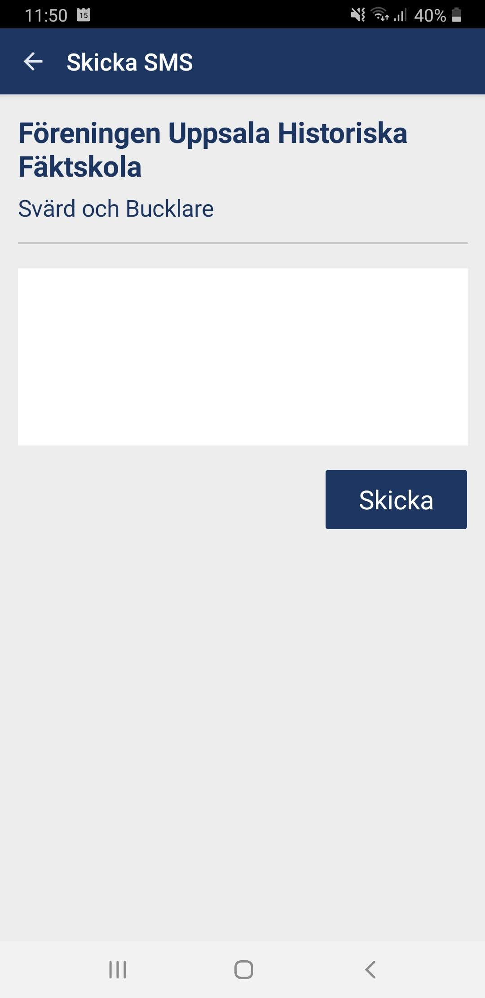
Sending messages using the mobile app
To send a text message to the group selected, first press “Meddelande” in the top menu.
Then press the plus-icon at the top right.
Enter the message you want to send, and press “Skicka”.
Only send messages if necessary.
Note that you cannot send an email through the app, and that text messages you send go to the entire group. In the web client, for comparison, you can select specific members to send messages to.

